Slide 1

Ready for GCSE Evening – DANCE
Subject Lead: Mrs Gray
AQA GCSE Dance
This course covers 2 key areas:
Practical - 60% | Theory – 40%
Performance and Choreography There are 3 sections: SOLO — perform 2 set phrases (1 min, 105BPM) (12 marks) DUET/TRIO — develop remaining 2 phrases (3 min) (24 marks) Plus an additional 4 marks for mental skills and attributes during performance CHOREOGRAPHY — create your own dance from a stimulus (40 marks) All assessed live and moderated by video footage in Year 11 by March 2028 | Dance Appreciation: Written examination — 1 hour 30 minutes (80 marks) Section A: questions on knowledge and understanding of choreographic processes and performing skills Section B: questions about YOUR own work Section C: questions on 6 professional set works. You will study: A Linha Curva, EoE, Within Her Eyes, Artificial Things, Shadows, Infra Develops your skills as an intelligent audience member Examination sat in the summer term of Year 11

Slide 2
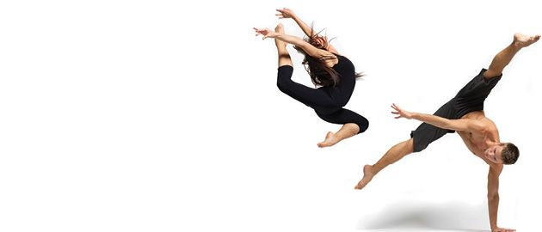
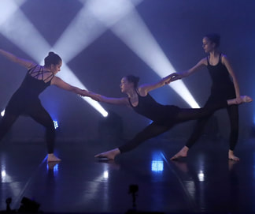
Ready for GCSE Evening – Dance
The most successful students in GCSE Dance:
Demonstrate a strong practical ability in performance and choreography
Have a good work ethic when it comes to rehearsing in and outside the classroom.
Students must understand the requirements of "describe", "explain" and "evaluate" and apply them to their written answers.
Enjoy learning the academic aspects of dance and not just the practical side.
Keep clear and organised notes to build up a revision resource.

Slide 3
Ready for GCSE Evening – Dance
Advice for doing well in dance:
Enjoy the subject – participate in dance classes regularly outside of lessons and engage well in all lessons.
Utilise all the resources given to you by your Dance teacher. This includes; past exam papers, revision material, subject content and performance criteria.
Video yourself dancing and learn to evaluate and critique your performance skills. Work on developing your weaknesses.
Complete past exam papers to get used to the style of questions – the more you complete, the better prepared you'll be.
Take part or watch a variety of dance styles at any opportunity you can – this means you will have plenty of ideas when it comes to the choreography element.

Slide 4
Ready for GCSE Evening – Dance
Resources and revision suggestions:
The following websites for helpful revision tips:
www.aqa.org.uk - specification, all criteria, revision and past papers
www.savemyexams.com - past papers
www.artspool.co.uk - support and resources
All workbooks printed in lessons will be handy revision resources

