Slide 1
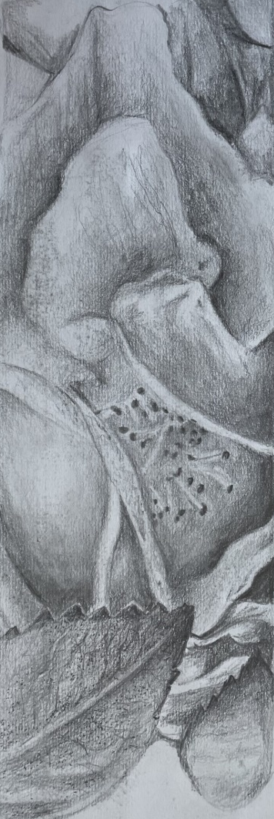

Ready for GCSE Evening – Art, Craft and Design
Subject Lead Name: Mrs Corrigan
Portfolio: (Coursework)
(96 marks) 60% of total GCSE
Time frames:
Portfolio Coursework:
September Year 10 – December Year 11
Externally set task:
Jan Year 11 – April Year 11
Externally set task: (Exam)
10 hours
(96 marks) 40% of total GCSE

Slide 2
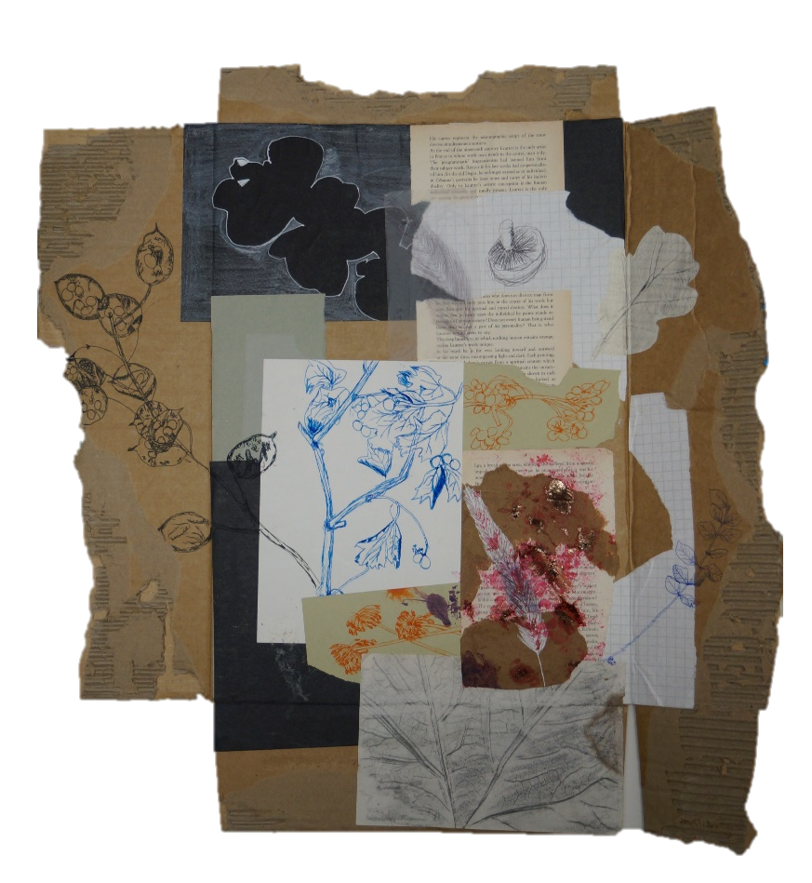
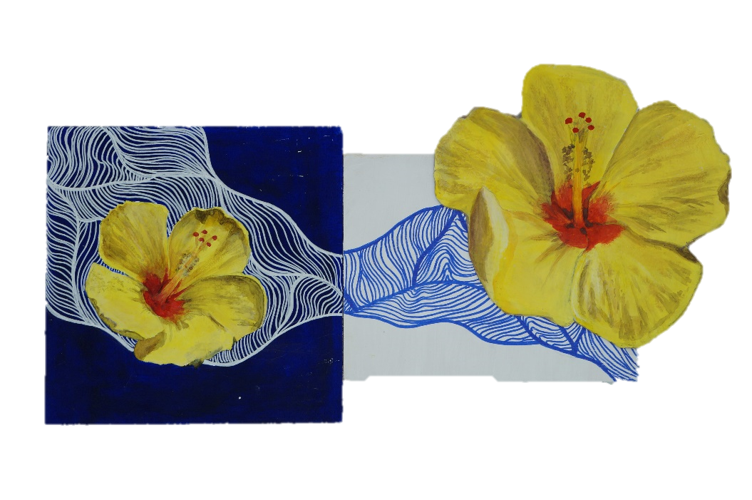
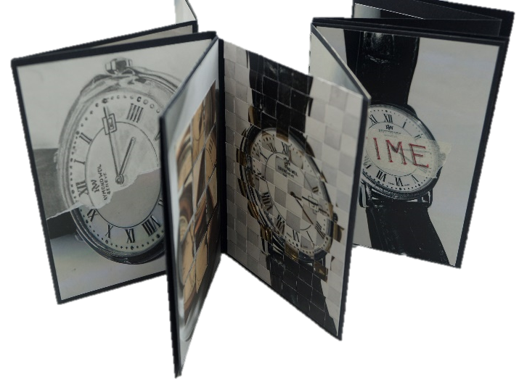
Ready for GCSE Evening – Art, Craft and Design
This course:
Coursework Our Art course begins at the end of Year 9 with a wonderful trip to RHS Wisley Gardens, where students take photographs and create observational drawings. In Year 10, they begin the main “Natural Forms” project, which introduces more advanced skills and techniques. This project forms 60% of their final GCSE grade. Alongside this, students will explore photography techniques by creating a mixed-media concertina book, inspired by artists. This helps them learn how to structure a project and conduct artist studies effectively, preparing them for the exam component.

Slide 3
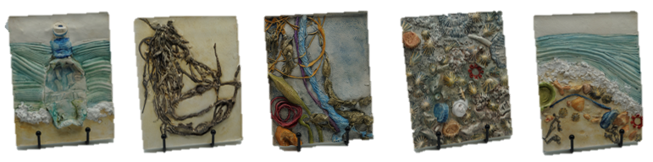
Ready for GCSE Evening – Art, Craft and Design
This course:
NEA (Exam)
In January of Year 11, students begin their NEA (Non-Exam Assessment) by selecting one of seven themes provided by the exam board. This will make up 40% of their GCSE. Each project starts with detailed research, a photoshoot, and drawings from their images. Students then develop and refine their ideas, using artist studies to guide and inspire their work. Projects are presented across large sheets and sketchbooks, with several outcomes that reflect their creative journey.
The NEA runs from January until the first week after the Easter break, when students complete their final outcome during a 10-hour practical exam.

Slide 4
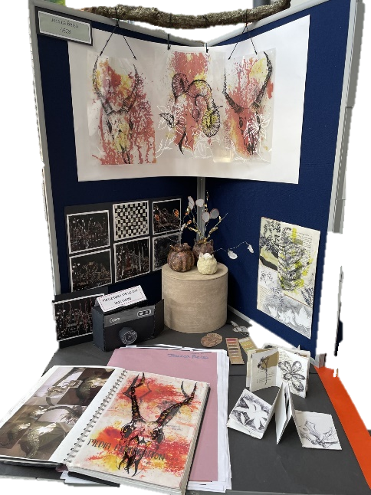
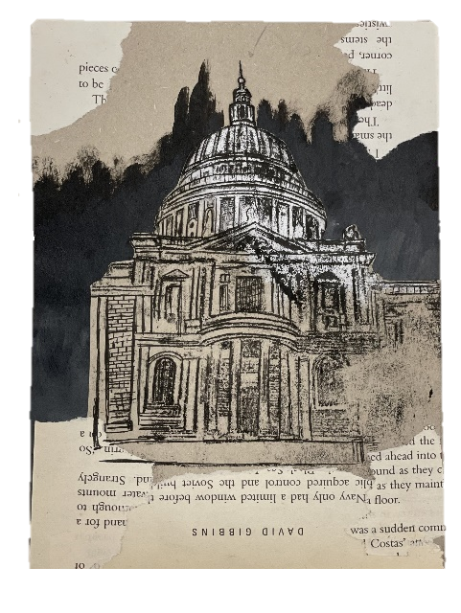
Ready for GCSE Evening – Art, Craft and Design
The Most Successful Students in Art:
The most successful art students begin with in-depth research, forming a strong foundation for their creative work. They show a clear visual and written progression, connecting their drawings, artist studies, and experiments to demonstrate how ideas develop. Through personal reflection, they acknowledge both successes and challenges, showing growth in thinking and making. Their final pieces are original yet clearly influenced by the artists they studied, with these links visible in both artwork and analysis. Careful reflection also helps them plan future work with intention.

Slide 5
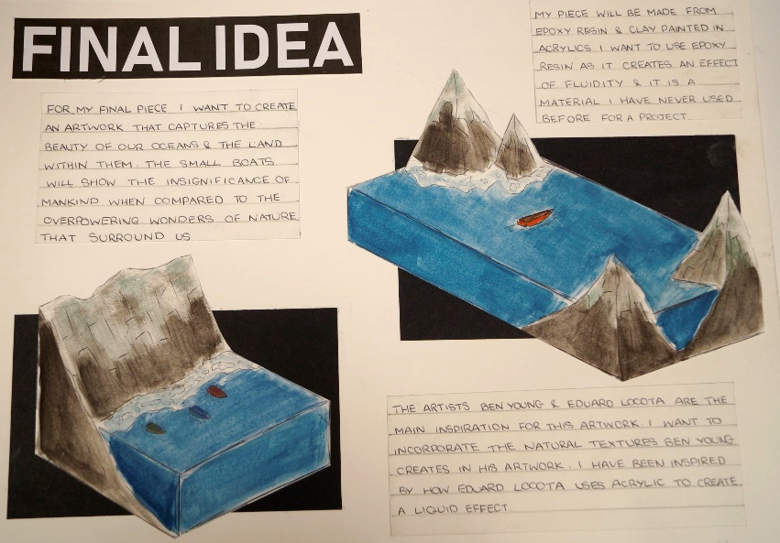
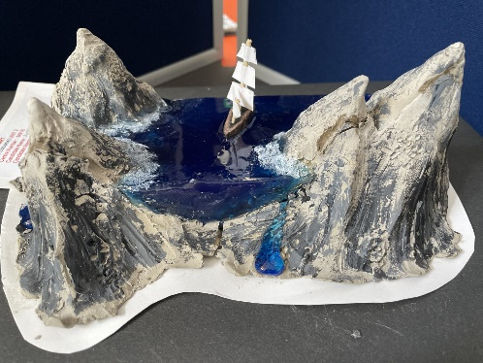
Ready for GCSE Evening – Art, Craft and Design
Our advice:
Be creative and take risks with your ideas.
Push yourself beyond what feels comfortable.
Research extensively to build a strong understanding.
Always know why you’re doing something.
Choose your source of inspiration carefully, so their style can naturally influence your own.
Good Habits to Build:
Use homework time wisely and stay on top of your personal targets.
Ask questions when you need help.
Take full ownership of your project—this is your chance to express your unique artistic voice.
Visit Art Exhibits – Get inspired and learn from real-world art.

Slide 6
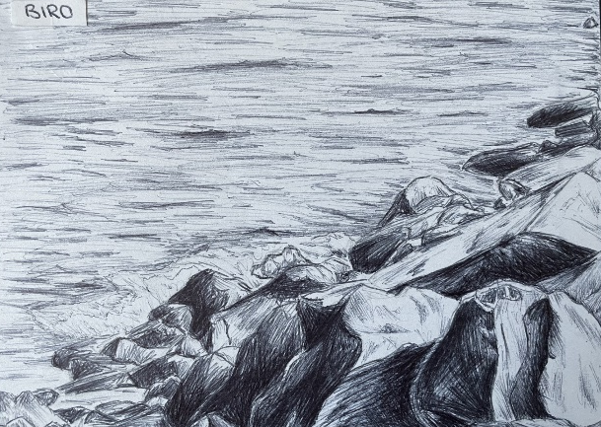
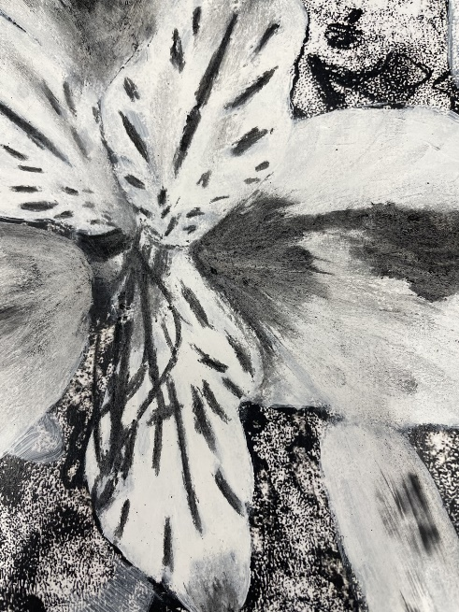
Ready for GCSE Evening – Art, Craft and Design
These are some really good places to go for help……..
Art Galleries & Museums
Google Arts & Culture: Explore thousands of artworks from museums worldwide
Virtual gallery tours, zoom-in on masterpieces, artist timelines
Tate Modern and Tate Britain: British and international modern art
Artist profiles, curated collections, exhibition guides
The National Gallery, London: Explore over 2,000 paintings by artists like Van Gogh, Turner, and da Vinci
The Victoria & Albert Museum (V&A):Decorative arts, design, fashion, and photography collection
The Metropolitan Museum of Art (The Met):Extensive collection from across the world and through history
The Museum of Modern Art (MoMA): Leading collection of modern and contemporary art

Slide 7
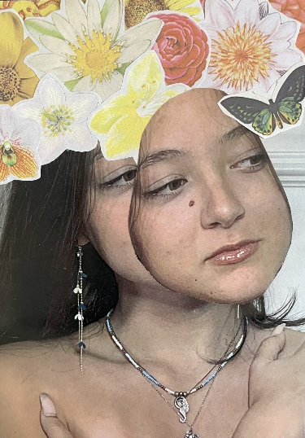
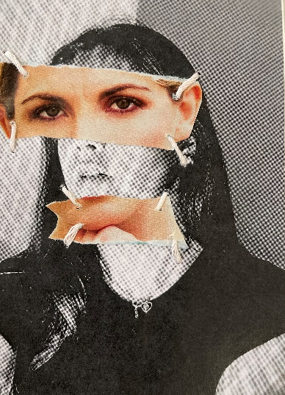
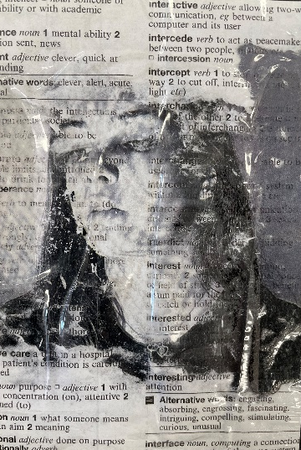
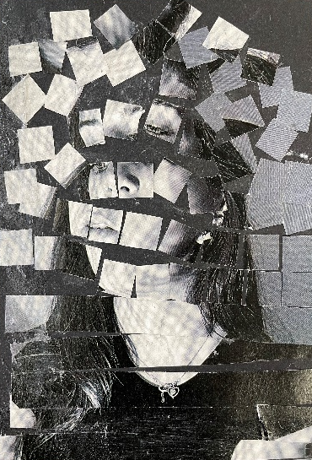
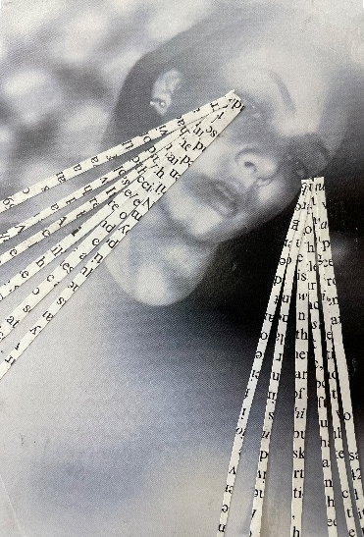
Ready for GCSE Evening – Art, Craft and Design
Photography-Focused Collections:
Magnum Photos - Powerful photojournalism and storytelling from iconic photographers
The Photographers’ Gallery - Contemporary photography exhibitions and artist features
V&A Photography Collection - One of the oldest and largest photography collections in the world
ICP – International Center of Photography - Features documentary, portrait, and conceptual photography
LensCulture - Discover innovative contemporary photography and competitions
YouTube Videos:
Watch relevant YouTube videos to explore how an artist created their work, the reasons behind their choices, and the possible meaning of their artwork.

